Slide 1
Transformer condition assessment with an integrated test van

Slide 2
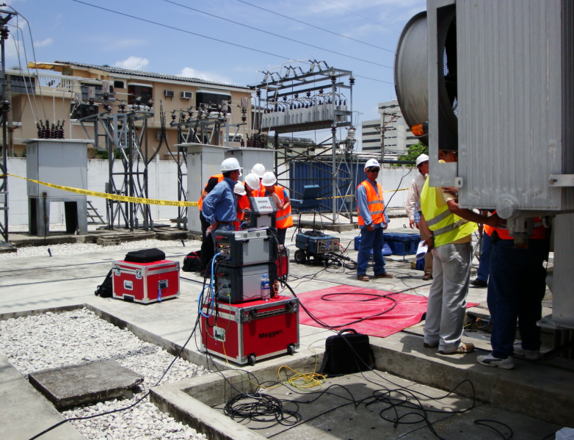

Slide 3
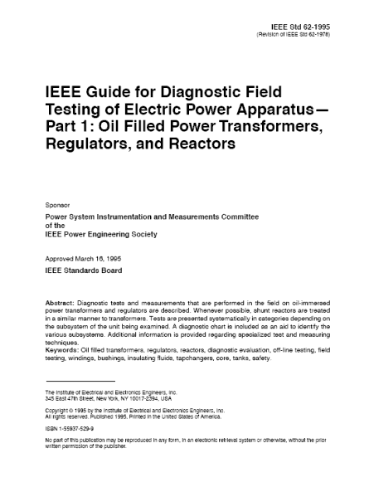
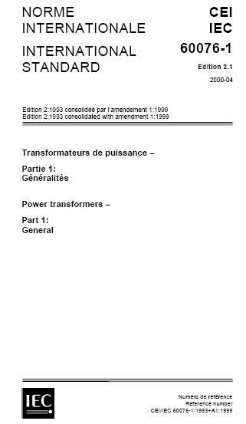
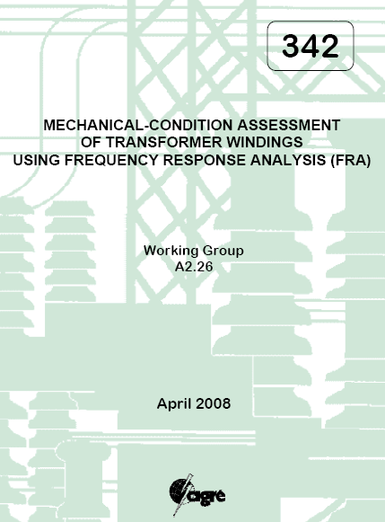
Testing and Standards for Power Transformers
CIGRE
CIGRE Brochure 342 (SFRA-FRAX)
CIGRE Brochure 414 (DFR-IDAX)
CIGRE Brochure 445 (Guide for Transformer Maintenance)
IEC, TC 14
IEC 60076-1, Power Transformers
IEC 60076-2, Temperature rise
IEC 60076-3, Insulation levels, dielectric tests and external clearances in air
IEC 60076-18, Measurement of frequency response (SFRA)
ANSI, IEEE Transformer Committee
IEEE C57.152 (former IEEE 62-1995)
IEEE C57.12.00-2006 (under revision)
IEEE C57.12.90-2006 (under revision)
IEEE PC57.149 (SFRA)
GOST
GOST 11677-85, Power Transformers

Slide 4
Guides and standards for transformer testing
Most standards (IEC and ANSI/IEEE) are focusing on new transformers and factory testing
Workgroups in e.g. Cigré have over the years produced a lot of Technical Brochures (TB) e.g. on sweep frequency response measurements (TB342), partial discharge (TB366), dielectric response measurements (TB414) etc
IEEE 62-1995 “Diagnostic Field Testing of Fluid-Filled Power Transformers, Regulators, and Reactors” is probably the most well-known guide for diagnostic field testing of oil filled power transformers. The guide today belong to the IEEE C57-series and last published revision is C57.152-2013
Notes:
4

Slide 5
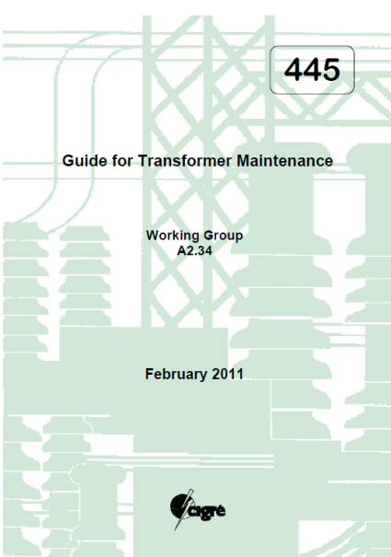
Cigré Technical Brochure 445, 2011 Guide for Transformer Maintenance

Slide 6
CIGRE TB 445
Cigré TB 445, ”Guide for Transformer Maintenance”, was published 2011
TB 445 is a comprehensive combination of education handbook, transformer encyclopedia and a guide for transformer maintenance including guidelines for how to perform measurements in the field
Notes:
6

Slide 7
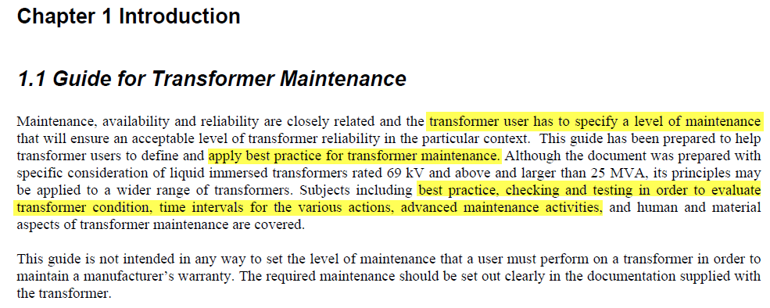
From CIGRE TB445 (2011)

Slide 8
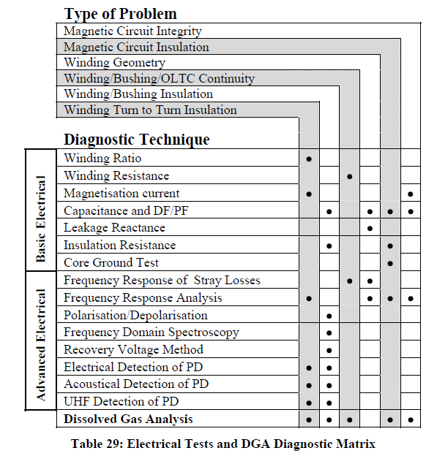
”Diagnostic” matrix CIGRE TB445
Notes:
8

Slide 9
Transformer testing by Megger
STANDARD TEST TYPES |  |  | MEGGER TEST SETS
Component |  | Test | Delta | IDAX | MIT | FRAX | MLR | TTR | MTO | LTC 135 | MoM | TRAX | OTS | KF
Windings |  | Resistance |  |  |  |  |  |  | X | X |  | X
 |  | Ratio/polarity |  |  |  |  |  | X |  |  |  | X
 |  | Excitation current | X | X |  |  |  | X |  |  |  | X
 |  | Short-circuit impedance |  |  |  | X | X |  |  |  |  | X
 |  | Frequency response analysis |  |  |  | X
 |  | Insulation resistance |  |  | X
 |  | Capacitance | X | X |  |  |  |  |  |  |  | X
 |  | Power factor/tan delta | X | X |  |  |  |  |  |  |  | X
 |  | Dielectric frequency response |  | X
Bushings |  | Capacitance | X | X |  |  |  |  |  |  |  | X
 |  | Power factor/tan delta | X | X |  |  |  |  |  |  |  | X
 |  | Dielectric frequency response |  | X
Insulating oil |  | Water content |  |  |  |  |  |  |  |  |  |  |  | X
 |  | Dielectric strength |  |  |  |  |  |  |  |  |  |  | X
 |  | Power factor/tan delta | X | X |  |  |  |  |  |  |  | X
Cellulose insulation |  | Moisture content |  | X
Tap changers | Load | Resistance |  |  |  |  |  |  | X | X |  | X
 |  | Ratio |  |  |  |  |  | X |  |  |  | X
 |  | Continuity (make before break) |  |  |  |  |  |  | X | X |  | X
 |  | Dynamic resistance (DRM) |  |  |  |  |  |  |  | X |  | X
 | De-energized | Resistance |  |  |  |  |  |  | X | X |  | X
 |  | Ratio |  |  |  |  |  | X |  |  |  | X
Core/Tank |  | Insulation resistance |  | X | X
 |  | Frequency response analysis |  |  |  | X
 |  | Ground test |  |  |  |  |  |  |  |  | X | X

Slide 10
So many tests to do?

Slide 11
Ambient conditions?
Or tangled cables?

Slide 12
Number of climbs up and down a ladder?

Slide 14
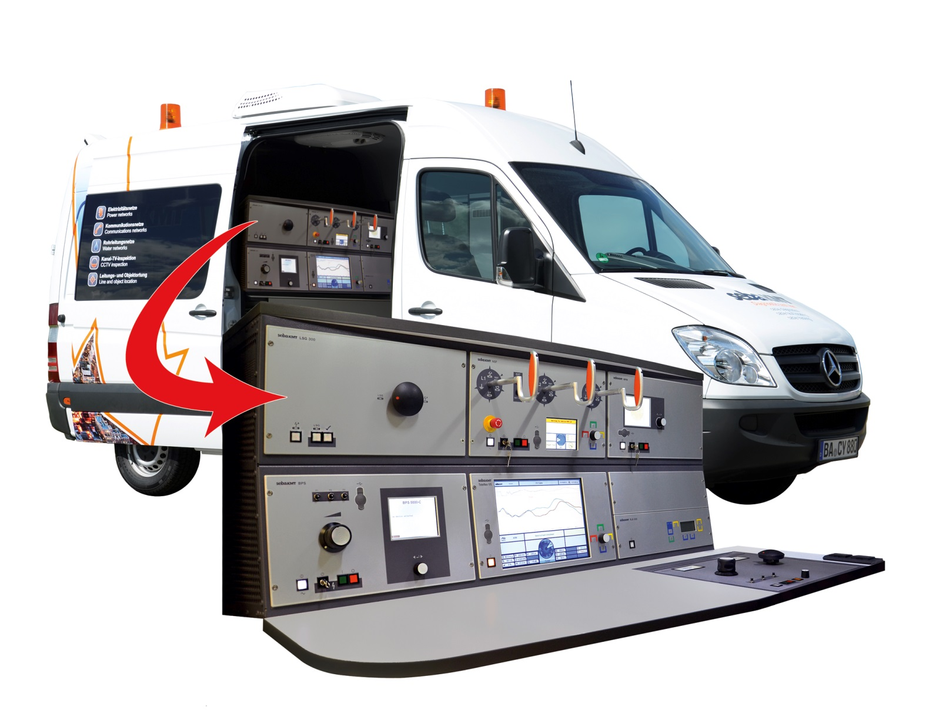
Cable test van
The Variant: cable fault location, cable testing and diagnosis in a modular system

Slide 15
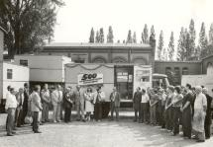
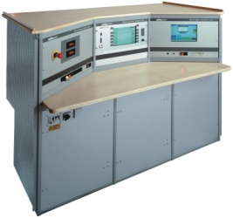
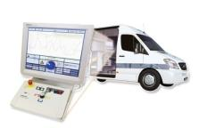
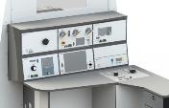
Historie Kabelmesswagen
History of cable test vans (SebaKMT)
First cable test van
2000 vans worldwide
4000 vans worldwide
Vario KMT
1000 vans to USSR
1969
1980
1985
1988
1995
1997
2006
2012
500 test vans delivered to USSR
Hitec 2000
Variant
Centrix 1/3-ph

Slide 16
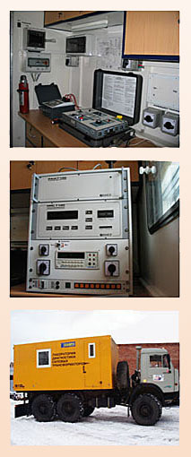
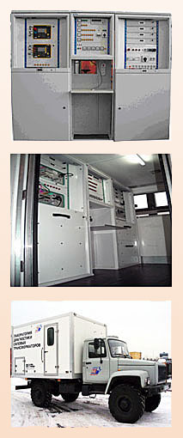
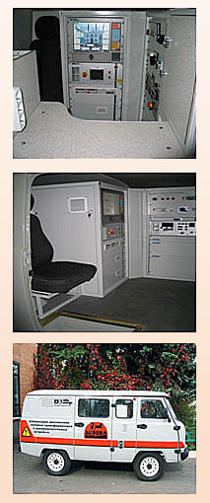
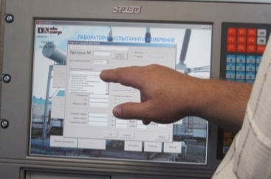
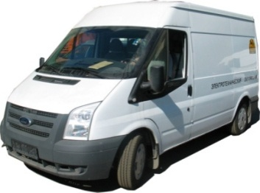
History of transformer test vans

Slide 17
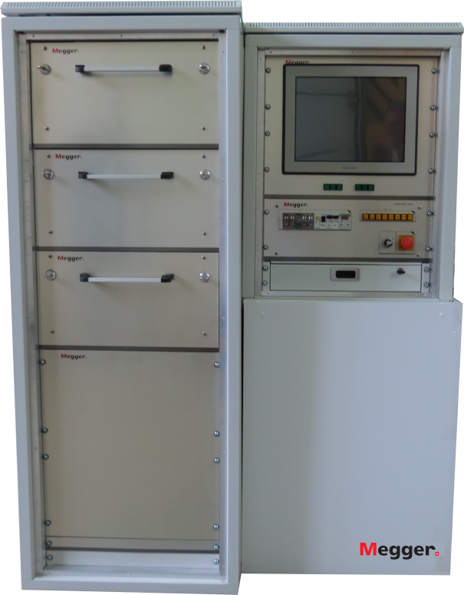
Operators view (inside)
Touch screen
Power supply, control and safety unit
Keyboard and mouse (exten-sible table)
19” cabinet drawers with test instruments inside

Slide 18
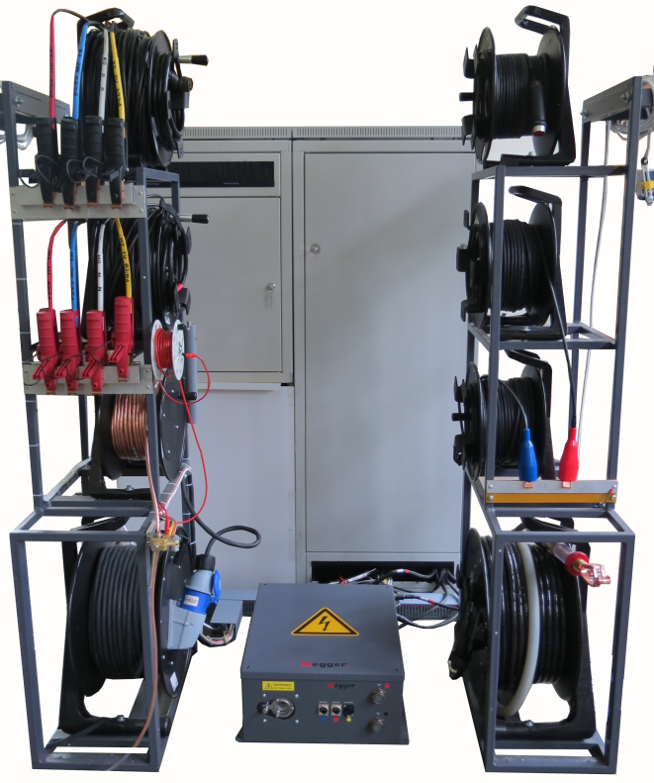
View from rear of van (“doors open”)
HV-LV Switch for measuring circuits
Safety / alarm system and cables
Drums 30 m cables for winding resistance / TTR tests (3ph + neutral, HV and LV side)
Protective earthing cable
Drums w. 30 m cables for HV tests (IR, tanD /Capacitance)
Drums w. mains supply cable

Slide 19
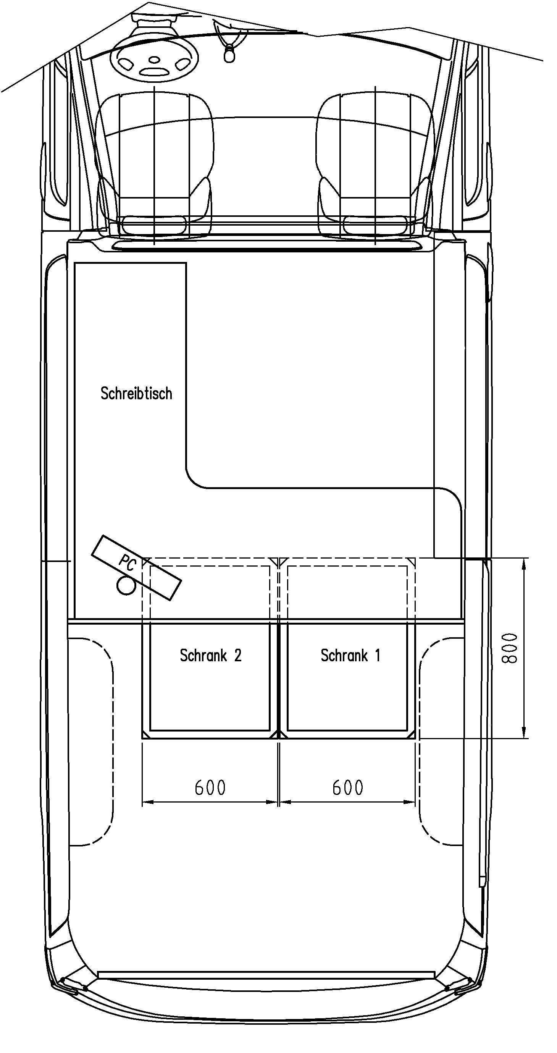
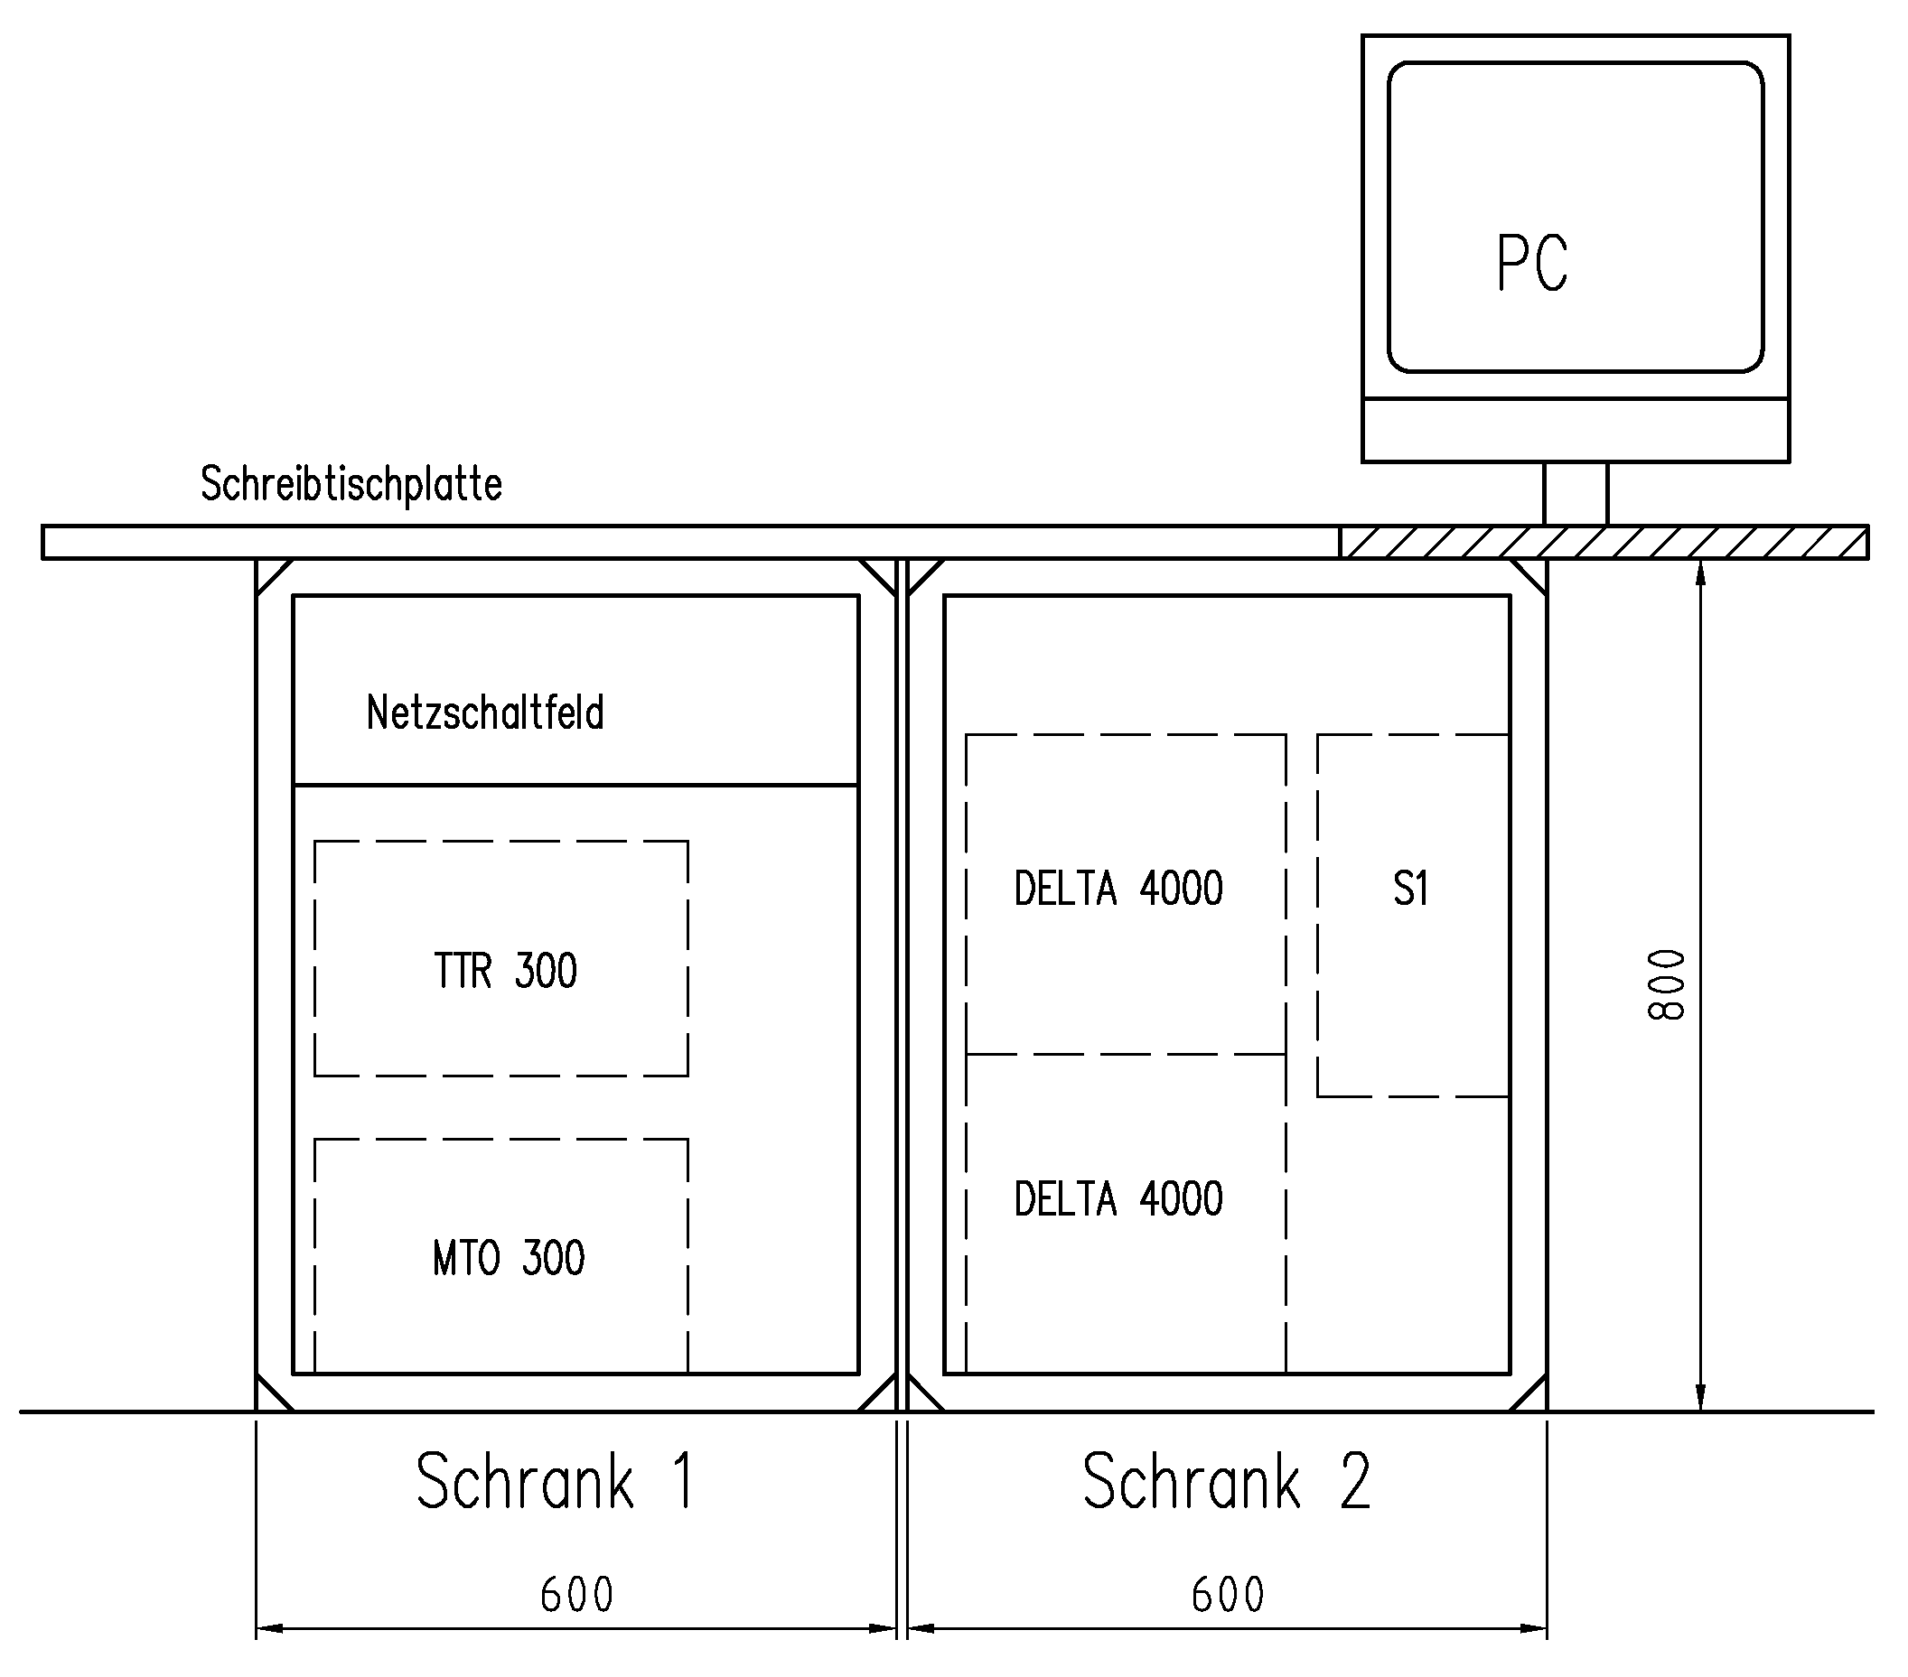
Concept for small vehicles:

Slide 20
HV commutator
tanD/C test
(Delta 4110) 10kV AC
HV cable, 30m
Measure «red», 30m
Insulation
Resistance
(S 1 -1068) 10kV DC
Measure «Blue», 30m
DFR/ Moisture
(IDAX 300 +VAX 2kV)
Interlock, 30m

Slide 21
LV commutator
Winding
resistance
(MTO300)
H multicable, A-B-C-N, 30m
X multicable, a-b-c-n, 30m
Turns ratio/
Phase
(TTR300)

Slide 22
External design

Slide 23
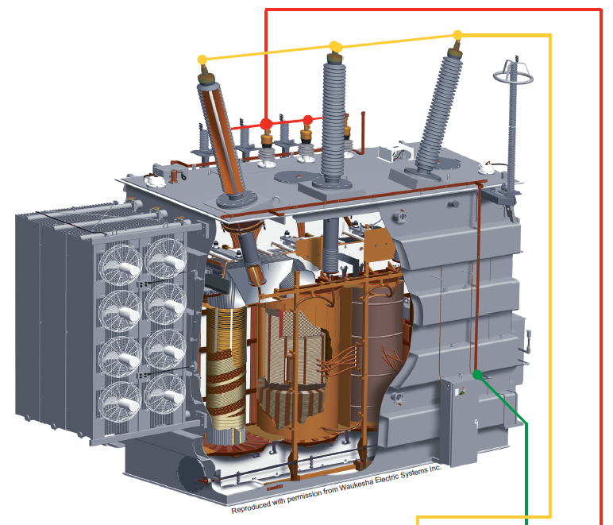
Designation
Commissioning
Preventive maintenance
Outage troubleshooting
After repair check
Issues that can be identified:
deterioration of electrical insulation
mechanical displacements/damage
winding-, bushing-, tap changer-, core- and oil condition
check for ratio, vector group, no-load& load losses

Slide 24
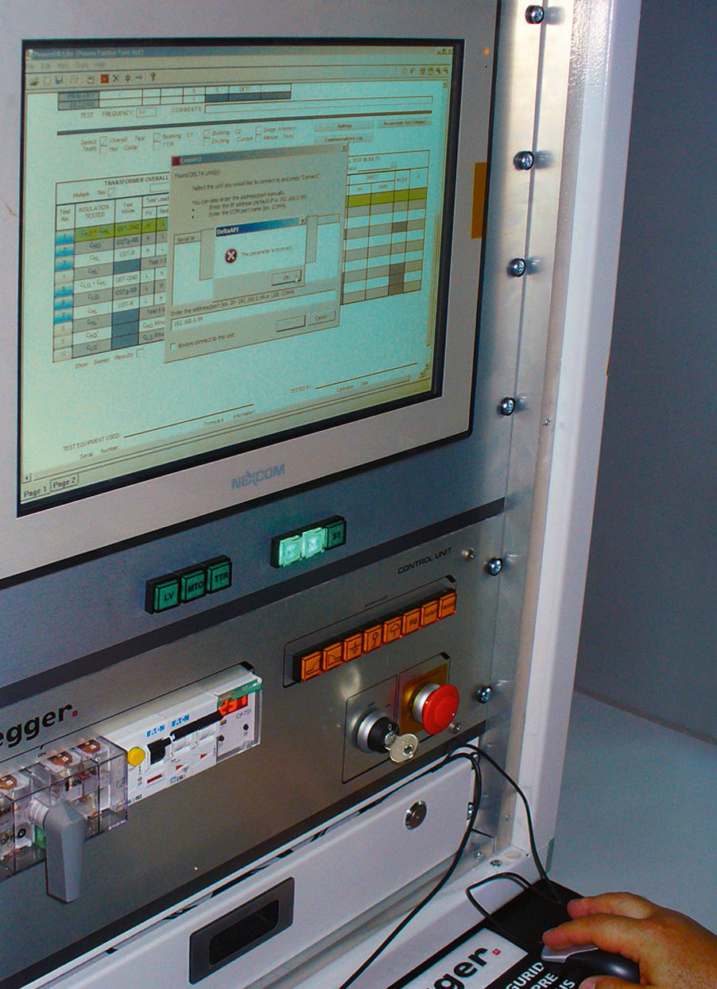
Unique features
Routine and advanced diagnostic tests
Centralized control and reporting
Two sets of cable (HV & LV) shared among instruments
Automated test circuit arrangement and switching process
Safe operation and user guidance through the tests

Slide 25
Routine and diagnostic tests onboard:
Insulation Resistance
DC Winding resistance / Tap Changer Test
Capacitance and dissipation factor for transformer and bushings
Turn ratio and vector group verification
Moisture-in-cellulose assessment with DFR technique
Short circuit impedance (optional)
Power losses for no-load and short circuit conditions (optional)
Frequency Response Analysis (optional)
Withstand tests at elevated voltage up to 100 kV AC 50 Hz and 70 kV DC (optional)
Oil breakdown test (optional)

Slide 26
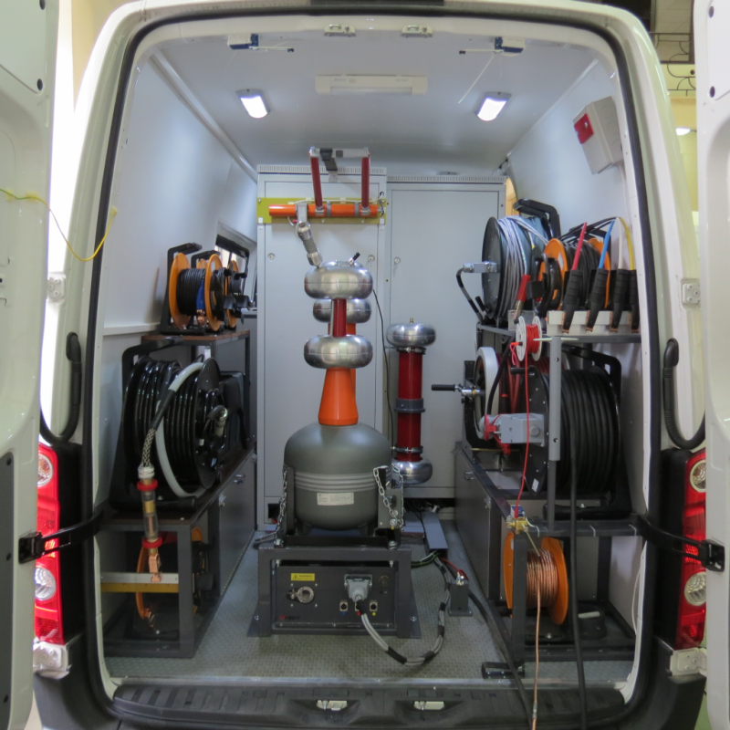
Optional: HV source on board
Single phase HV source
100 kV AC 50 Hz
70 kV DC

Slide 27
Optional: power loss measurement at reduced voltage
Loss measurement at reduced voltage of 380 / 230 V is a good compromise under on site conditions (due to limitations in power and voltage sources)
No-load circuit
Short circuit condition
Important to have a factory data on losses at reduced voltage as reference!

Slide 28
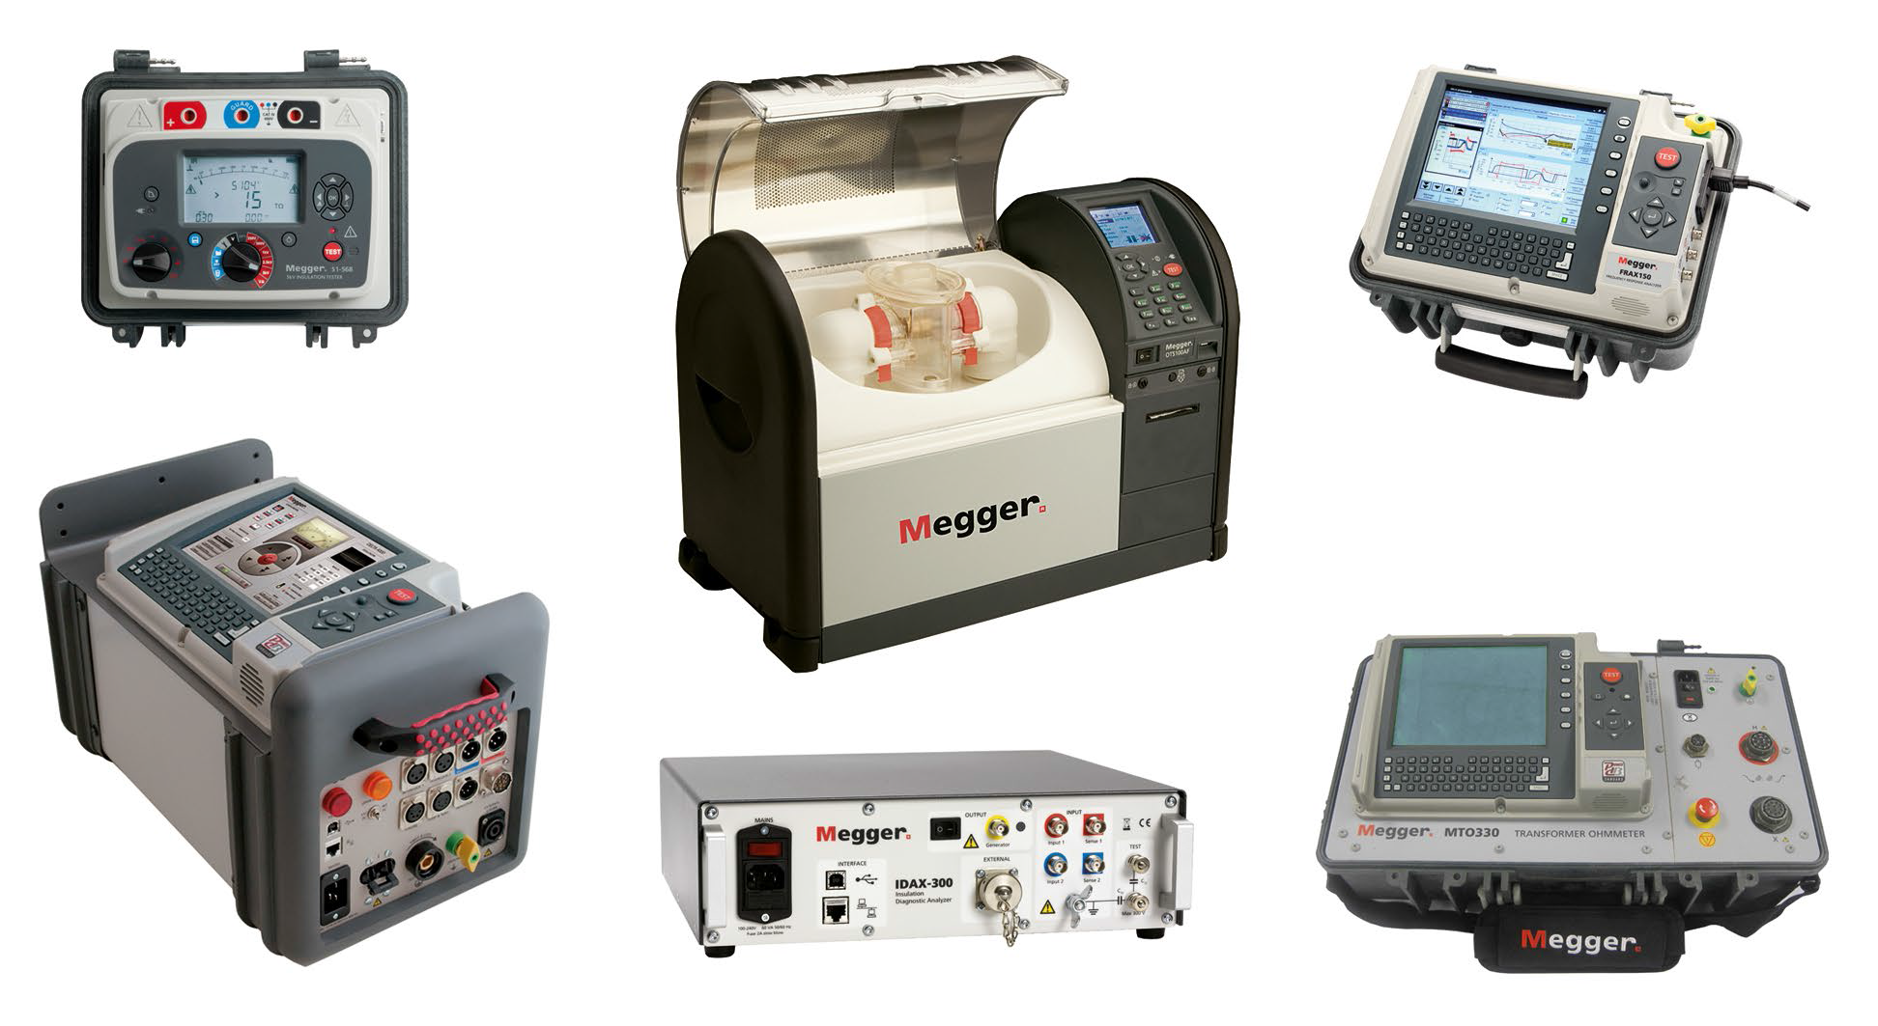
Well-known components:

Slide 29
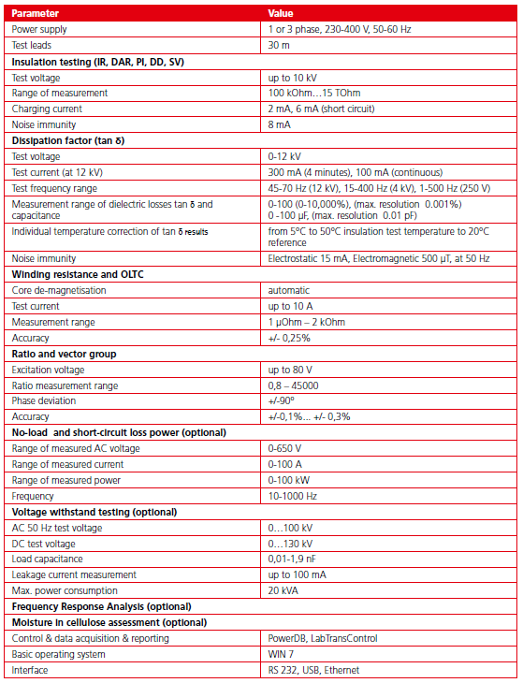
Specification:

Slide 30
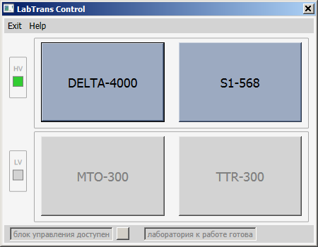
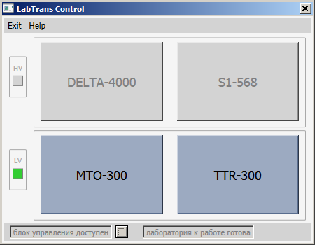
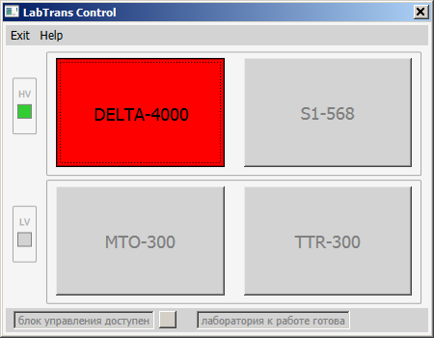
Software: Device selector

Slide 31
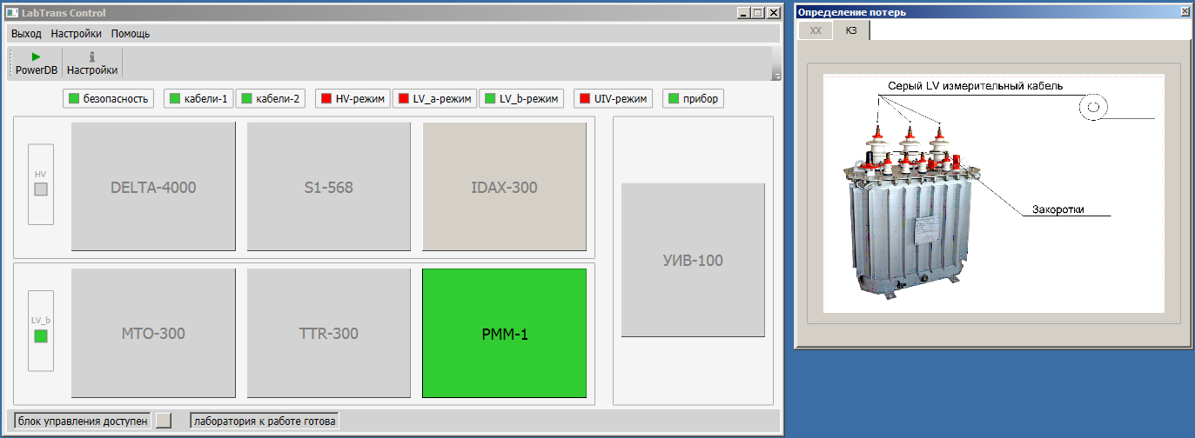
Optional: power loss measurement at reduced voltage
Important to have a factory data on losses at reduced voltage as reference!

Slide 32
Software: PowerDB

Slide 33
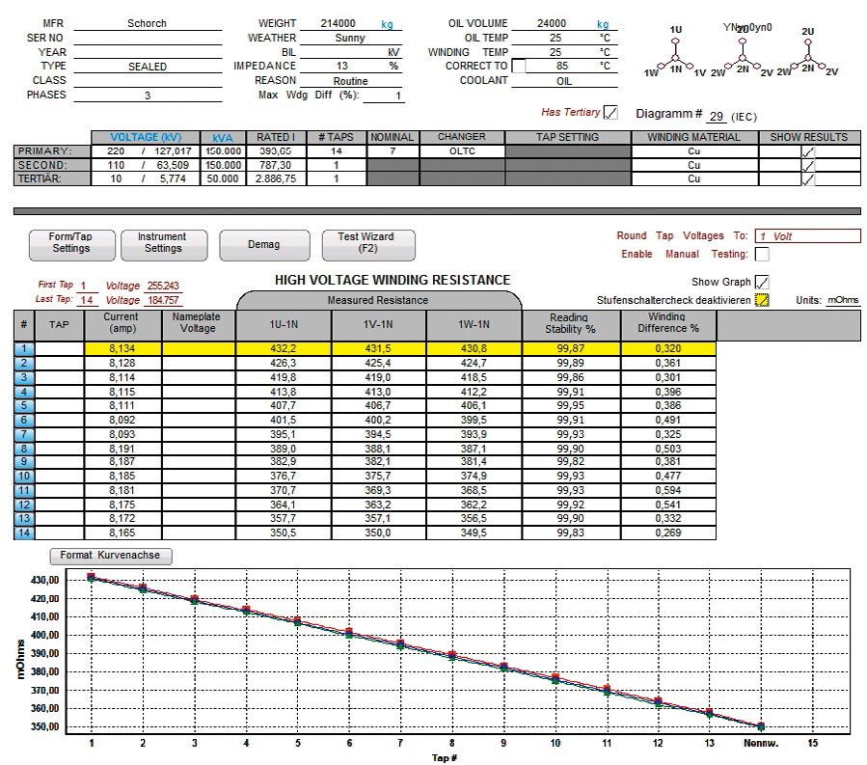
Complete report with PowerDB

Slide 34
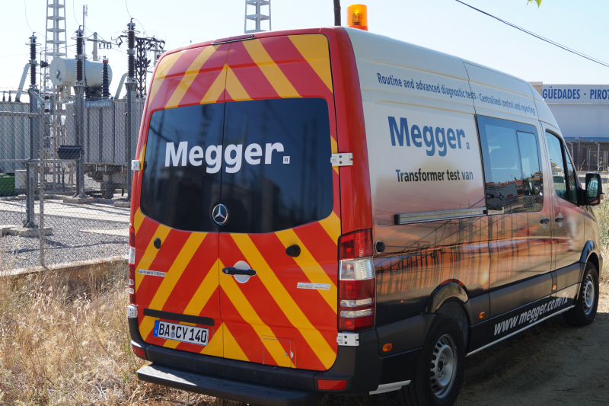

Slide 35
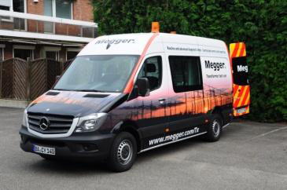
Conclusions
Transformer test van concept:
combines routine electric tests and advanced diagnostic techniques
allows a complete transformer check in field.
Field experiences:
substantial testing time saving >70%
help prevent accidents
Streamlined data handling:
reporting, database for assessing results, comparing w previous tests and eventually establishing trend of the transformer condition

Slide 36
Thank you!

